Slide 1
IoT DDoS prevention
Leveraging Edge technology
Vinod Lasrado
Rajiv Ramanathan

Slide 2
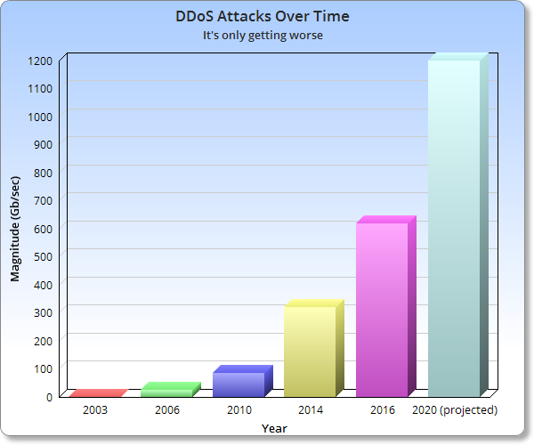
Why are we talking about this?
DDoS started in early 2000s.
Number of Attacks are increasing
Does not only disrupt the service attacked.
“Things” are easy targets.
MIRAI

Slide 3
Gap in current implementation
Billions of devices
Can’t upgrade all.
Cloud based solutions
Too far from devices.
Current solutions
Based on mitigation

Slide 4
Edge to the rescue
Closer to the “things”
More computing power.
Fewer than “things”

Slide 5
Problems with edge
Sees lower amount of traffic
Not powerful as the cloud.
Need to collaborate with other edge functions.

Slide 6
Some Existing Techniques
Anomaly based Techniques
Signature based Techniques
Filtering

Slide 7
Recently Proposed Solution
ShadowNet
IP based attack detection.

Slide 8
Problems and solutions
High data rate variation not required at edge.
Use more than metrics
DDoS similar to flash floods
Figure out a way
Less processing power than cloud
Lightweight implementation required
Balance between edge function and cloud function
Use sampling or metadata

Slide 9
Our focus
Using other metrics and techniques to improve DDoS detection eg.
Flow based
Rate change detection
Use of sampling or metadata for further improvement

Slide 10
Resources Required
Good news, we are simulating.
Haven’t decided the exact simulator

Slide 11
Deliverables
Software for DDoS detection
Simulation results

Slide 12
Any ?

